Slide 1


Data API Builder
Create an API for your database in seconds
Jess Pomfret · datagrillen 2026
Notes:
Welcome. I'm Jess. Today we're going to talk about Data API Builder — but I'm going to start with a story.

Slide 2



Jess Pomfret
(She/Her)
Data Platform Engineer
LinkedIn Learning Instructor
Open Source Contributor
dbatools, MicrosoftFabricMgmt
Passionate about Automation, Proper Football & Fitness
jpomfret7@gmail.com
jesspomfret.com
linkedin.com/in/jpomfret/

Slide 3
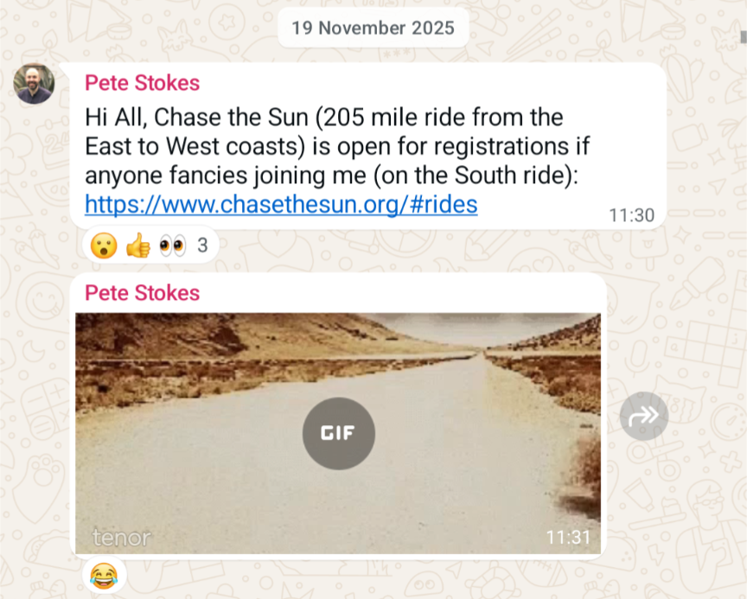
if I wanted to cycle 205 miles in one day…
One day someone asked
Notes:
Last November I got a text message in a gym cycling group
Pete said ‘hey does anyone want to do this’ … and I thought – what a terrible idea, absolutely not…
And then…
Wait a min….

Slide 4
On 20th June 2026, I'm cycling 205 miles… in one day!
Notes:
Big number, sets up the bet. Pause. Let it land.
what a great plan 🤣

Slide 5
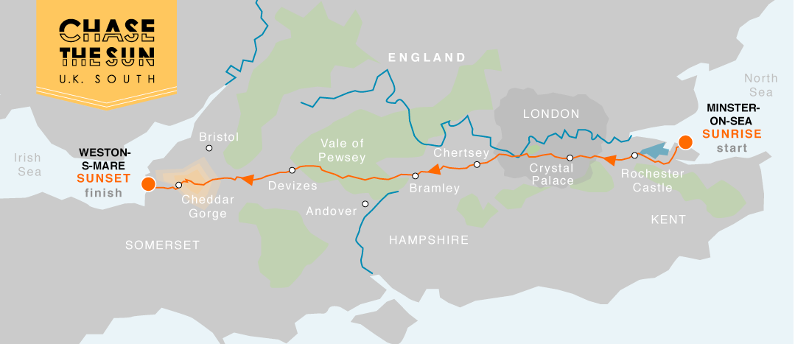
Chase the Sun 2026
205 miles. Minster-on-Sea to Weston-Super-Mare
Sunrise to sunset. One day. Coast to coast.
3 days after my 40th birthday.
Notes:
3 days after my 40th birthday – midlife crisis anyone?

Slide 6




The Problem?
Getting to the start line. Trained. Fuelled. Ready
Notes:
It’s also worth saying that I have a somewhat addictive personality – which tends to mean when I’m in… I’m all in….

Slide 7
This has generated a lot of data
Wellness, fitness, fueling.
Many devices. Many Apps. No shared view. No way to query it together.
I'm a data nerd. I want it in my database.
Notes:
This has generated a lot of data – and I thought what better way to procrastinate writing this presentation… than building something to solve this problem, while showing how cool DAB really is – so here we are!
Heart Rate Variability (HRV) is the measure of the variation in milliseconds between consecutive heartbeats
Rate of Perceived Exertion (RPE) is a subjective 1–10 scale
And when I say there has been a lot of data…

Slide 8
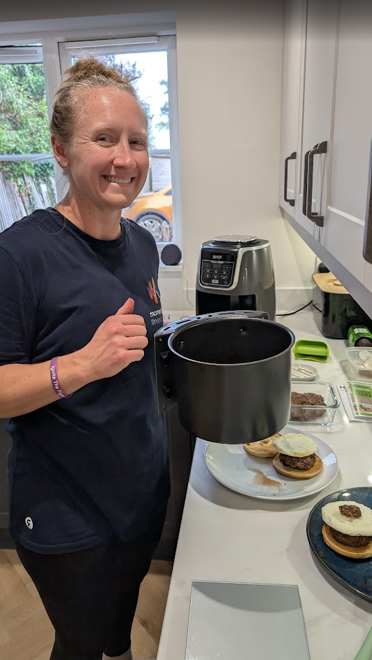
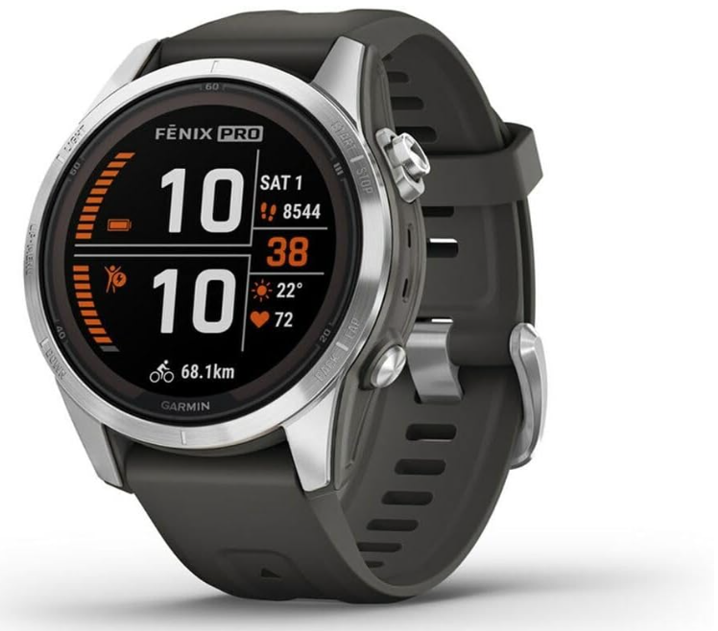
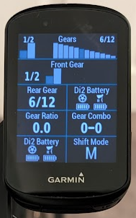
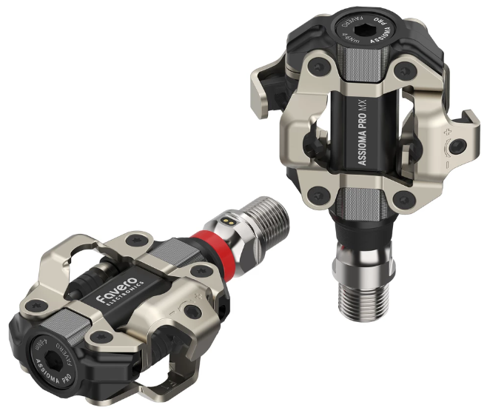
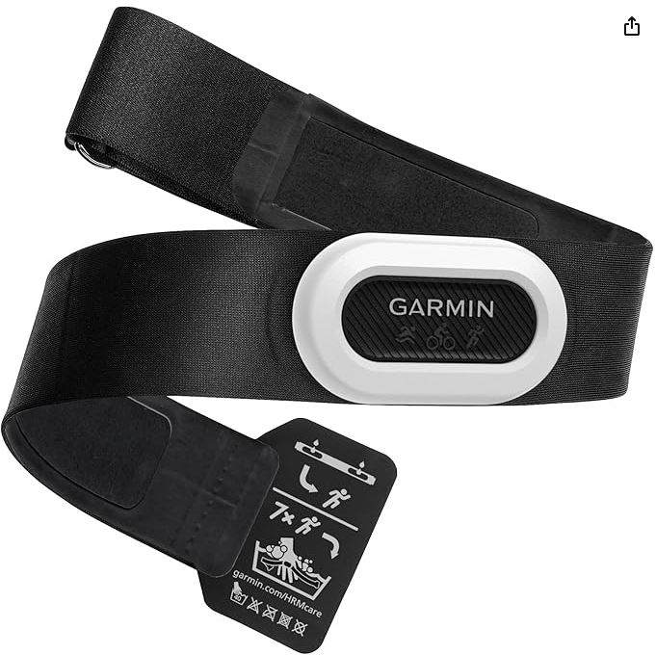
No… like A LOT of data
Notes:
We’ve got sleep stats, heart rate, heart rate variability, body battery, recovery, training readiness all coming from my Garmin watch
And We’ve got bike ride data coming from a Garmin edge head unit – distance, speed, maps of where I’ve been
+ HR strap for more accurate HR reading
+ power pedals – how much force I’m putting through the pedals
And we’ve got weights and calories of all the food that my wife is cooking, and I’m busy eating…
The last few months have been a lot of cycling, eating, recovering… and obviously working (literally my whole team is here shh)
Heart rate, sleep, HRV, RPE, distance, speed, power, fueling

Slide 9
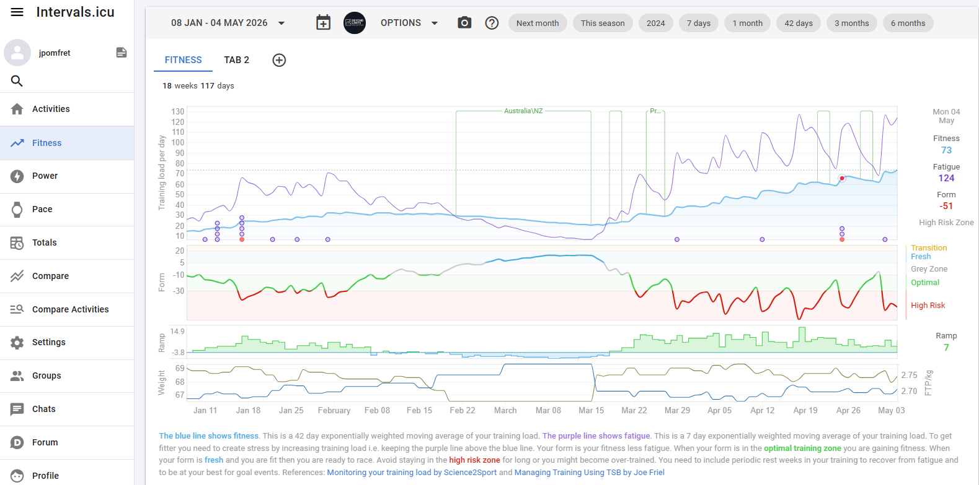
Intervals.icu
Notes:
So most of this data goes via Garmin into intervals.icu a great open source tool for training data
They have all kinds of metrics, and explanations on metrics
And all kinds of graphs – this top one is fitness vs fatigue, basically if you keep the purple fatigue line above the blue fitness line your fitness will increase
You can see the opposite happened while I was in Australia
But too much training is bad, so also aim to keep this form line close to green…
You can also plan your training here, chat to other cycling nerds, but nothing for weight\nutrition

Slide 10
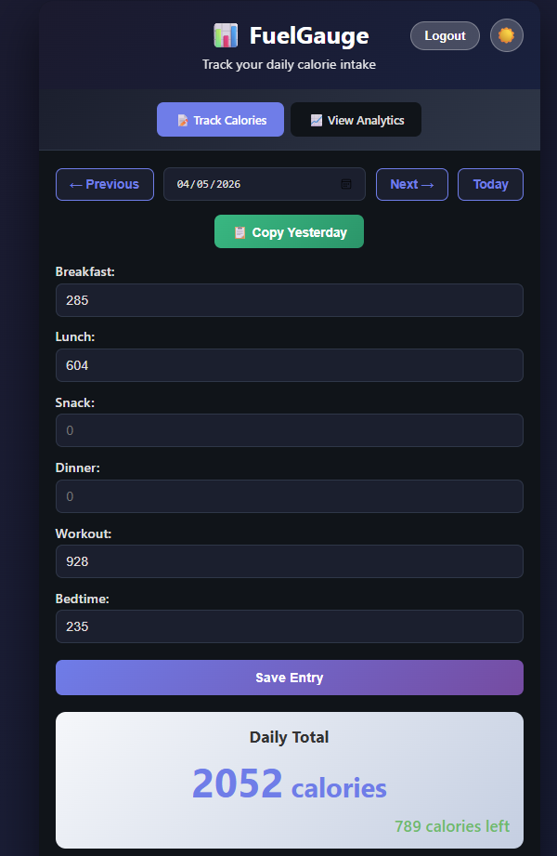
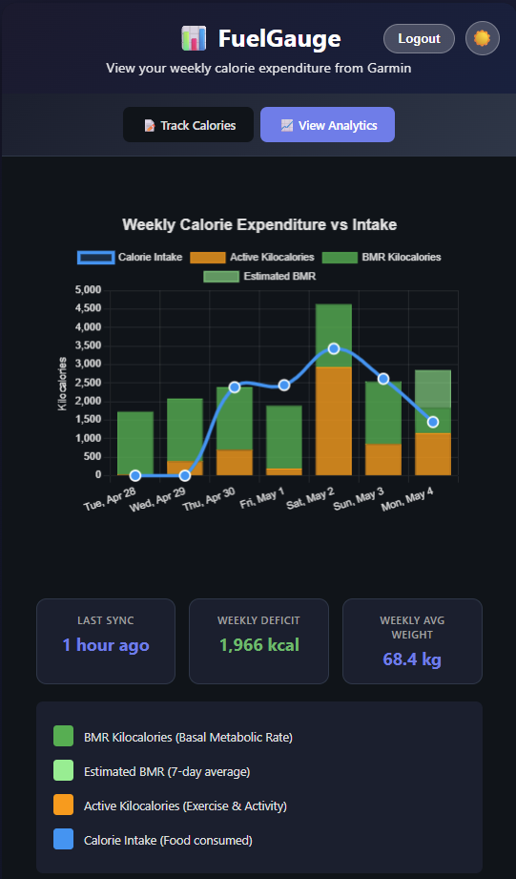
FuelGauge
Home grown app
Tracks Calories Consumed
Compares to Calories Burnt
Stored in postgres & influx databases running on Kubernetes (don’t ask)
Notes:
So I built my own simple app
And then I built my own app to track my calories consumed, it pulls in data from Garmin for my daily calories burned to make sure I’m eating enough \ not eating too much

Slide 11

One place. One way in. One way out.
Everything in SQL Server.
PowerShell writes to it.
A dashboard reads from it.
I do not want to write a backend.
Notes:
I want to collect my data – load it into my Azure SQL Database – we’ll use Data API Builder as the API layer
We can use DAB to create GET and POST endpoints – meaning we can get and set data using this – and it’s so simple to get it set up

Slide 15
What is Data API Builder?
Notes:
Ok so remember why we’re here… DAB not Jess’ cycling adventure
What is it?

Slide 16
What is DAB?
A config-driven REST, GraphQL & MCP (preview) layer over your database.
Point it at SQL Server, Postgres, MySQL, or Cosmos DB.
It serves your tables, views, and stored procs over HTTP.
No backend code. Just configuration.
Notes:
Basically create a simple config file in JSON
Tell DAB about the config file
API magic
It’s that easy

Slide 17
What it isn't
Not an ORM.
Not a full backend framework.
Not a replacement for your stored procs.
Not magic — auth, rate limits, business logic still need thinking about.
Notes:
Live demo part two. Show the schedule view, walk through how planned TSS compares to actual TSS, and the projection out to 13 June.

Slide 18
Architecture
SQL Server
(or Postgres)
DAB
(config-driven)
REST + GraphQL
endpoints
One config file describes which entities are exposed and how.
Notes:
Simplest setup – we have a database, we have DAB running in a container say, and then we can access the endpoints

Slide 19
The config file
One JSON file. Two important parts: data source and entities.
{
"data-source": {
"database-type": "mssql",
"connection-string": "@env('DATABASE_CONNECTION_STRING')"
},
...
"entities": {
"IntervalsWellness": {
"source": {
"object": "dbo.IntervalsWellness",
"type": "table"
},
"permissions": [{ "role": "anonymous", "actions": ["read"] }]
}
}
}
Notes:
Simplest form of config
Using an environment variable for the connection string
Exposing one table for read (GET) access with no authentication
The name of the entity ‘IntervalsWellness’ in this example will become the API endpoint

Slide 20

Deployment
One container image.
Multiple ways to run it.
01
Docker container
Single image, runs anywhere — local dev, CI pipelines, or bare-metal servers. Just point it at your database.
02
Azure Container Apps
Serverless container hosting with auto-scale. No cluster to manage. Pay only for what you use.
03
Azure App Service
Managed PaaS with built-in auth, custom domains, and deployment slots. Familiar to any .NET team.
04
Azure Kubernetes (AKS)
Full orchestration if you already run K8s. Helm chart included.
Fits into your existing cluster.
All options use env vars or JSON config — zero code changes between environments
Notes:
Deployment — four options, one container image
Docker container:
- The DAB runtime ships as a single Docker image from Microsoft Container Registry.
- docker run is all you need for local development — pass your connection string as an environment variable.
- Same image works in CI pipelines for integration testing — spin it up, run tests, tear it down.
- For bare-metal or VM deployments, just run the container directly. No framework dependency on the host.
Azure Container Apps:
- Recommended starting point for most teams. Serverless — you don't manage infrastructure.
- Built-in auto-scale from zero to N replicas based on HTTP traffic. You pay per request, not per VM.
- Supports revision-based traffic splitting for canary deployments.
Azure App Service:
- If your team already runs .NET apps on App Service, DAB slots right in.
- Deployment slots give you blue-green deployments out of the box.
- Built-in auth integration with Entra ID (formerly AAD) — no code changes needed.
Azure Kubernetes Service (AKS):
- For teams that already operate a K8s cluster. Helm chart is provided.
- Fits into existing service mesh, observability, and scaling policies.
- Most operational overhead — only choose this if you already have the K8s muscle.
Key message: identical image everywhere. The only thing that changes between environments is the config — connection strings, auth settings, CORS rules. All of that lives in environment variables or a JSON config file, never in source code. Connection strings should be stored in Azure Key Vault and referenced via env vars.

Slide 21
Demo: dab in 2 mins
Notes:
After demo
So you can see how easy it is to get started with DAB locally
But it’s also got some cool baked in features out of the box

Slide 22
Run it anywhere
dab CLI locally. Docker image everywhere else. Same config, same behaviour.
# local
dab start --config dab-config.json
# container
docker run -p 5000:5000 `
-v ${PWD}:/App/configs `
-e DATABASE_CONNECTION_STRING `
mcr.microsoft.com/azure-databases/data-api-builder
Notes:
Or you can run it locally

Slide 23
Invoke-RestMethod is all you need
$base = 'http://localhost:5000/api'
# write a row
$body = @{ date = '2026-05-04'; type = 'Ride'; tss = 84 } | ConvertTo-Json
Invoke-RestMethod "$base/Activity" -Method POST -Body $body `
-ContentType 'application/json'
# read it back
Invoke-RestMethod "$base/Activity?\$filter=type eq 'Ride'" |
Select-Object -ExpandProperty value
Notes:
demos

Slide 24
Pagination
$first — limit results to N items per page. Default is 100.
$after — cursor-based pagination. Pass the continuation token to get the next page.
No offset-based paging — cursors are efficient on large datasets.
Response includes hasNextPage and endCursor.
GET /api/Activity?$first=25&$after=eyJpZCI6MTAwfQ==
Notes:
Like paging results – we don’t want to overwhelm clients receiving this data – so chunk it into pages
First 25 records
After the record with id 100 – that’s base encoded
Offset-based paging means the database has to skip more rows each time and so gets slower and slower
Cursor-based paging jumps straight to the point in the index, id > 100 and then grabs the next 25 rows

Slide 25
Filtering & querying
$filter — OData-style expressions: eq, ne, gt, lt, contains, startswith.
$select — return only the fields you need. Less data over the wire.
$orderby — sort ascending or descending on any exposed column.
GET /api/SyncLog?$filter=Source eq 'IntervalsSync'&$orderby=RunAt desc&$first=10
Notes:
Filtering & querying — the built-in query surface
$filter:
- OData-style filter expressions on any exposed column.
- Supports: eq, ne, gt, ge, lt, le, contains, startswith, endswith.
- Combine with AND/OR logic: $filter=type eq 'Ride' and distance gt 50.
- DAB translates these to parameterised SQL — no injection risk.
$select:
- Project only the columns you need. Reduces payload size over the wire.
- Particularly useful for wide tables — instead of returning 40 columns, pick the 5 you need.
- Example: $select=date,distance,tss returns only those three fields.
$orderby:
- Sort on one or more columns: $orderby=date desc, distance asc.
- Sorting happens server-side in the database — not in memory in the API layer.
- Default sort order is by primary key if $orderby is not specified.
Key point for the audience: these are standard OData query parameters. If anyone has used Power BI, Dynamics, or any Microsoft data API, the syntax is identical. No learning curve.
The REST endpoint and the GraphQL endpoint both support filtering. REST uses query-string parameters; GraphQL uses typed filter arguments in the schema.

Slide 26
Relationships & GraphQL
Define relationships in the config file — DAB maps foreign keys and exposes nested data automatically.
One request returns parent + children — no client-side joins, no N+1 queries.
The GraphQL endpoint lets callers ask for exactly what they need — nested fields, aliases, fragments.
{ athletes(filter: {team: {eq: "A"}}) { name, activities { date, type, distance } } }
Notes:
Relationships & GraphQL — nested data without custom code
Relationships:
- Defined in the config file under each entity's "relationships" section.
- You specify the source and target entities, the linking columns, and the cardinality (one-to-many, many-to-one).
- DAB generates the join logic — no stored procedures, no views required.
- One API call returns parent + child records together — eliminates N+1 query patterns on the client.
GraphQL endpoint:
- DAB auto-generates a full GraphQL schema from your entity definitions.
- Callers request exactly the fields they need — no over-fetching, no under-fetching.
- Supports nested queries that follow the relationships you defined — e.g., query an athlete and get their activities in one request.
- Supports aliases, fragments, and introspection out of the box.
- The GraphQL endpoint lives at /graphql on the same host as the REST endpoint.
When to use REST vs GraphQL:
- REST is simpler and works with any HTTP client — good for CRUD and straightforward queries.
- GraphQL shines when the client needs flexible field selection or traverses relationships — fewer round-trips, exactly the data shape you want.
- Both endpoints are always available simultaneously — no need to choose one at deploy time.
Demo tip: show the GraphQL playground at /graphql — it has auto-complete and schema docs built in. Let the audience explore the schema interactively.

Slide 27
Demo: Chase the Sun tracker

Slide 28
The setup
Intervals.icu
Azure SQL DB
DAB
Wellness dashboard
FuelGauge

Slide 29
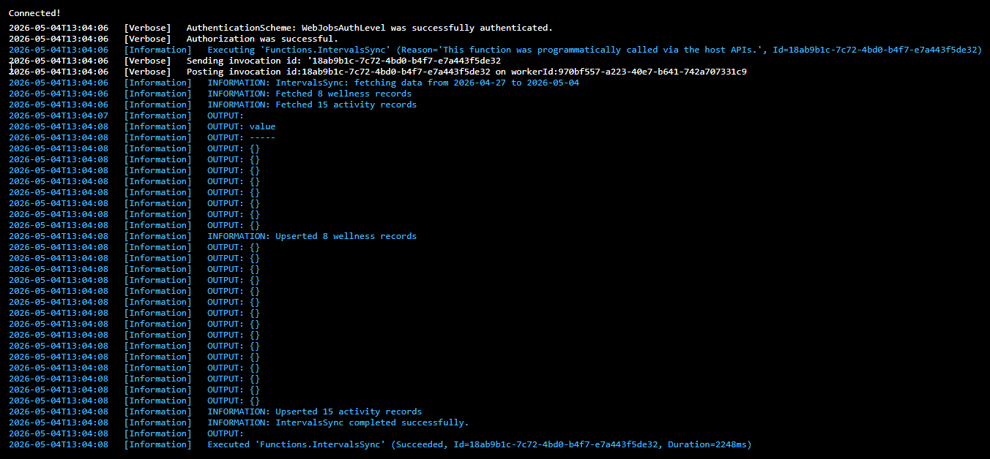

Slide 31
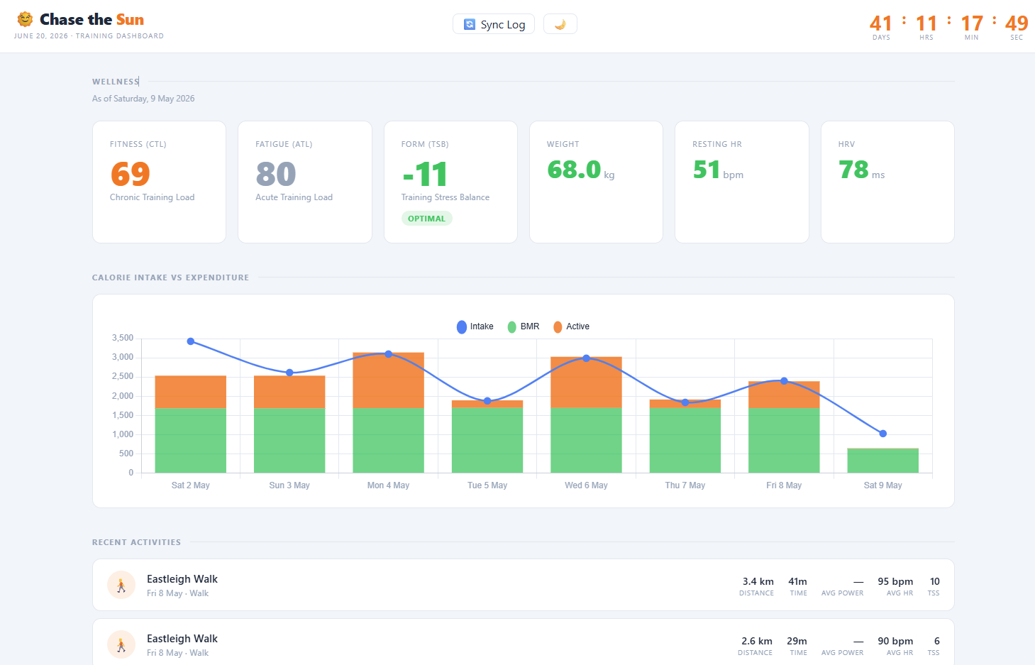
Demo: Wellness dashboard

Slide 32
When not to reach for DAB
Heavy business logic — keep it in the database or a real backend.
Public-facing at scale — auth and rate limits need real thought.
Shaped responses — reach for a view or a sproc.
Multi-tenant separation — design it into the schema.

Slide 33
Resources
Docs — aka.ms/dab
Repo — github.com/Azure/data-api-builder
Deck + demos — github.com/jpomfret/dab-presentation
Find me — jesspomfret.com · Jess Pomfret on LinkedIn
Watch this space for the Chase the Sun post-mortem.

